Slide 1
PCPO
Contract Support Meeting
January 16, 2025

Slide 2
Welcome!
We’ll get started in just a moment.
Please change your name to say the position you hold at your school, followed by your name
  example: Teacher, Bob Saget
Notes:
MK

Slide 3

Announcements

Slide 4

Family Ed Workshops
Building Connection through Physical Play
with Patty Wipfler from Hand in Hand Parenting
February 18th, 7pm
Register Here
For schools who have already purchased an Education Package, share this link with your membership to register for the workshop.
If you would like to purchase this workshop for your membership, fill out this form.
Please consider making a donation on
behalf of your school or as an individual.
Family Education Package
Notes:
Bethany

Slide 5

Teacher Education Workshop
Brain-Based Behavior in the Classroom
Monday, January 27th, 7:00pm
How does neuro-research help us understand why children struggle with behavior and emotional regulation. This workshop will focus on identifying contributing factors, forming behavior hypotheses, and selecting effective strategies for support.
Notes:
Bethany

Slide 6
Teacher Education Registration
If your school has not purchased an education package, your teachers can sign up for the workshop as a single event for $25.
Register Here
If your school has purchased an education package, your teachers will receive an email about registering for the workshop.
Notes:
Bethany

Slide 7
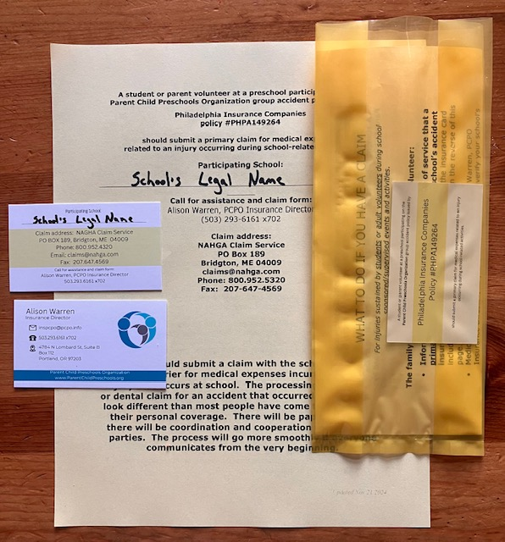
Accident Insurance Update
New accident policy inserts were mailed to schools in November.
It is essential that schools update their ‘Yellow Pockets” with these new materials and destroy old materials.
Failure to update insurance materials can lead to delay and complications with the insurance claim process.
Notes:
Alison

Slide 8
Accident Claim Process
The PCPO Insurance Director must be informed of an injury as soon as possible when a student or adult volunteer has a school-related injury requiring medical attention.
When a student or adult volunteer suffers a school-related injury:
School provides initial report of injury to PCPO Insurance
Insurance Director will send school representative a list of questions.
School representative will provide answers as soon as possible.
Insurance Director will send school representative accident insurance claim form, with instructions to complete with injured party and submit to claims processing service.
School representative will submit completed form directly to the claims service as soon as is reasonable, with a goal of within 10 days of the injury.
Your school just needs to remember step one!
We will walk you through the rest!
Notes:
Alison
goal to submit claim form within 10 day of accident (before bills arrive to claims service). important that schools provide prompt notice and response.

Slide 9

Upcoming Events
January
21 (Tuesday, 7 pm) General Meeting
27 (Monday, 7 pm) Teacher Education
February
18 (Tuesday, 7 pm) Family Education
March
8 (Saturday, 9:30 am) Teacher Education
April
15 (Thursday, 7 pm) General Meeting
May
20 (Tuesday, 7pm)
NOW -New Officer’s Workshop- Meeting
Notes:
Bethany

Slide 10
Your Cooperative Teacher: a unique role
Notes:
Break outs

Slide 11
Small Group Discussion
What is a meaningful thing a cooperative teacher (or parent!) provides in the classroom?
What is something meaningful your teachers (or parent) provides outside the classroom?
Besides teaching, what important roles does your teacher(s) fill in your school?
Notes:
Bethany

Slide 12

Notes:
Molly lead a quick call for sharing about the breakouts
Tara - difficulty in comps
Penny: do you want me to talk about this? This slide is where most of my notes related the last 2 years.
Family education – not just ed, whole relationship
Penny – teacher (and ex public school employee) perspective

Slide 13
PCPO Resources
“The Cooperative Preschool Teacher”
Resource for both board and teachers! Explores the unique role of the cooperation preschool teacher, what should be expected of the membership, board, and teacher team, more negotiations tips, and a sample self-assessment form.
“The Seven Wonders of a Healthy President-Teacher Relationship”
Great tips on how to foster a cooperative and production relationship with your teacher!
Notes:
Bethany

Slide 14
Teacher Contract Negotiations
Notes:
Alison - check on this one

Slide 15
PCPO’s
Contract Support
Goals
Our mission is to provide support and resources to cooperative preschools, including their boards and teachers.
PCPO recognizes preschool teachers as professional educators and advocates for fair and professional compensation.
PCPO recognizes preschool boards are rotating volunteers and strives to provide tools and resources to facilitate successful, cooperative negotiations.
Notes:
Molly

Slide 16

Contract negotiations are conversations between the teacher and a select committee of school members. The goal of these conversations is to reestablish agreed upon responsibilities and compensation for your school’s greatest asset - your teacher!
As cooperative organizations, we value the process of consensus decision making, and encourage schools to adopt this approach in their contract negotiation processes.
Some negotiations will be quick, others will need more time and conversation. Remember! Everyone comes to the table with the best interests of the school and teacher at heart.
Notes:
Molly

Slide 17



PCPO Contract Support Materials
PCPO contract support documents contain goals, guidelines, and recommendations
Compensation and benefits provided will vary between schools!
Each co-op school is different!
PLEASE REMEMBER! The numbers presented in this report are PCPO’s recommended minimums. They are not absolutes or requirements!
Notes:
Molly

Slide 18



General Recommendations
Pay teachers an annual salary (vs hourly)
Schools should have a stated timeline for contract negotiations
Starting now!
Compensation should not be based on enrollment numbers
Notes:
Molly

Slide 19



General Recommendations (cont.)
Personnel file for all employees.
Personnel files are confidential!
Long Range Plan
If your school is paying significantly below PCPO recommendations, consider a long-term plan to raise salary.
Plans can be written into the contract to inform future negotiations.
Bonuses
PCPO does not recommend anticipated bonuses that are written into the teacher’s contract.
Notes:
Molly

Slide 20
General Recommendations (cont.)
In addition to clearly listing salary, responsibilities, and other benefits, your contract might include:
  Who will negotiate the next contract
  Conflict resolution procedure
Notes:
Molly

Slide 21
Contract Process
Schools should have a written and agreed upon process and timeline for contract negotiations.
  Don’t have one? Write one!
  Refer to PCPO’s President Handbook and Treasurer Handbook for additional board resources on contract negotiation.
Contract Negotiations should be conducted via committee, not just one person.
  Use of a committee creates shared responsibility and helps avoid bias based on personal experience/situation.
Notes:
Bethany

Slide 22
Contract Committee
Who is on your committee?
  Your school’s by-laws or handbook may have details as to who is on the committee.
PCPO Recommends a three-person committee
  Commonly President, Treasurer, and Teacher Liaison.
  ‘Teacher Liaison’ is a mutually agreed upon third member of the committee, recommended by the teacher. Can be anyone from current membership or alumni.
Teacher is often advisor to the committee for ‘things’ like process and job responsibilities.
Committee reaches agreement with teacher. Executive board votes to approve
Everyone on the team must be knowledgeable about the financial situation of the school
Notes:
Alison – committee comes up with recommendation, must be approved by board. – emphasize understanding your own process

Slide 23
Timeline
Establish a timeline!
  Helps keep everyone on track
  Lets the employee know what to expect and when
Do your homework!
  Everyone on the contract committee, including the employee, needs to be knowledgeable about the school’s financial situation.
  All parties should come prepared to the negotiation table!
  Prior to meeting with teacher, the committee should discuss ranges of compensation increase and know how they might affect the budget.
    Establish a range of what can be agreed to on the spot, and what might warrant further discussion in committee.
  The more prepared you are, the smoother the process will go!
Contracts must be finished before your budget can be finalized
  You cannot set a budget before salary is established
Notes:
Alison- board responsible for timeline, respectful to employee,

Slide 24
What do you call a boomerang that won’t come back?
A stick!

Slide 25

What goes in a contract?
Notes:
MK

Slide 26



A contract should clearly outline
Responsibilities
Expectations
Compensation
Notes:
quick overview - MK

Slide 27
Contract Contents
Teacher Responsibilities
Days worked per week, start/end dates
Arrival and/or departure time
Trainings, general and board meetings, parent education, parent conferences
Notes:
MK

Slide 28
Contract Contents
Expectations of Teacher
Pediatric CPR/First Aid Certification
Parent Conferences
Professional Development
Attendance at Board Meetings
Communication – from and to Board
Notes:
MK

Slide 29
Contract Contents
Compensation
Salary
  How much?
  When (and how) paid?
Reimbursements
Contingencies
Special and/or additional circumstances
Benefits
Notes:
MK

Slide 30
Contract Contents
Additional Considerations
Many schools offer benefits in addition to an annual salary, including:
Continuing Education Funds
Professional Membership Dues
Leave Policy
Notes:
MK

Slide 31
Leave Policy
Schools and teachers should consider a leave policy, covering medical, personal, and professional leaves
PCPO schools approach leave policy in various ways:
  Some provide long-term leave policy for personal or family emergencies.
  Some schools allow sick/personal leave time to roll-over/accumulate year to year.
  Other schools pay out unused leave at end of year or let it expire if unused.
Both Oregon and Washington have state mandated sick leave policies. See the PCPO Teacher Contract, Salaries, and Benefits packet for more information.
Notes:
Alison

Slide 32
Benefits
Benefits vary a lot between schools. Not all schools are able to provide the same benefits. Some benefits reported by PCPO teachers include:
Professional Membership Dues
  ORAEYC / WAEYC
  NAEYC
  Other
Wellness Support
Flexible spending account
Retirement plan
Childcare
Mileage Reimbursement (excludes to and from work)
Benefits, including tuition discounts, may be taxable. Refer to the IRS rules on Fringe Benefits for more information. https://www.irs.gov/publications/p15b
Notes:
must do your own due diligence - Alison

Slide 33
Benefits
Mileage Reimbursement
As of January 1, 2025, the IRS rate mileage rate is 70¢/mile
Information available at www.irs.gov
Note: While not common, mileage rates can change during the year. PCPO provides standard mileage rate updates in the Compliance Corner feature of our Connection newsletter.
Notes:
updated for 2025 – Alison

Slide 34
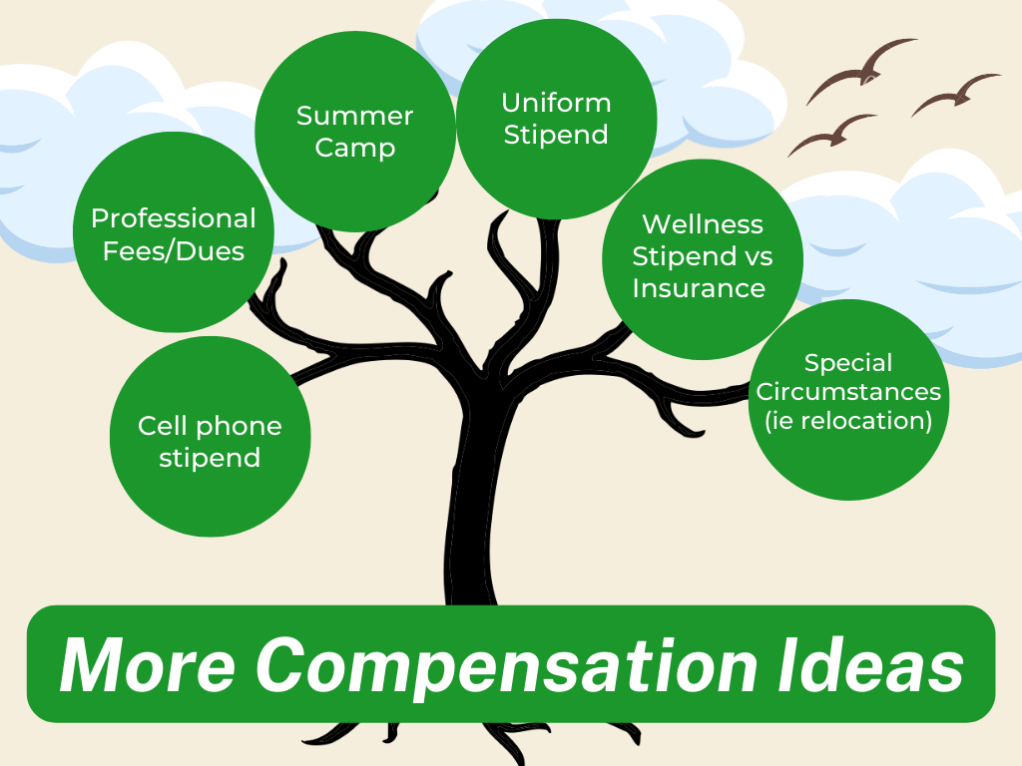
Notes:
Bethany

Slide 35

Negotiating an equitable and thorough contract can be challenging and time-consuming. But the benefits of having a fair, complete and appropriate contract are immense.
Notes:
Molly

Slide 36
2025
Teacher Survey
Results
Notes:
Bethany- provide range, 21 teachers, 15 schools

Slide 37
Each year, PCPO surveys all member-school teachers to gather information on current trends in compensation and benefits.
The following information is based on 21 teachers from 15 different schools for the 2024-25 contract year. This represents approximately 27% of PCPO member teachers.
Notes:
Bethany

Slide 38
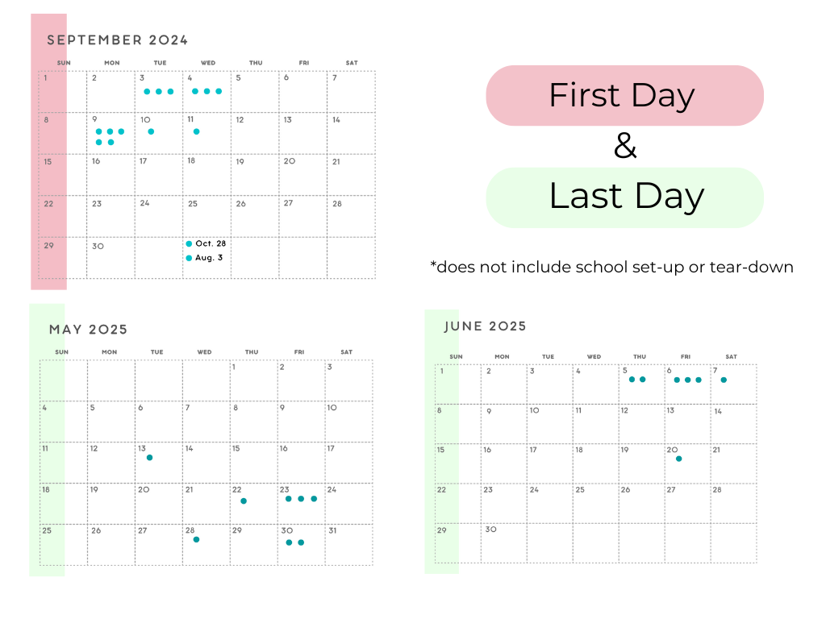
Length of school year varied from 32 to 42 weeks with an average of 38.5.
The majority of schools begin after Labor Day and end after Memorial Day. There is greater variation in the last day of school.
Notes:
Alison lots of variance in schools –

Slide 39
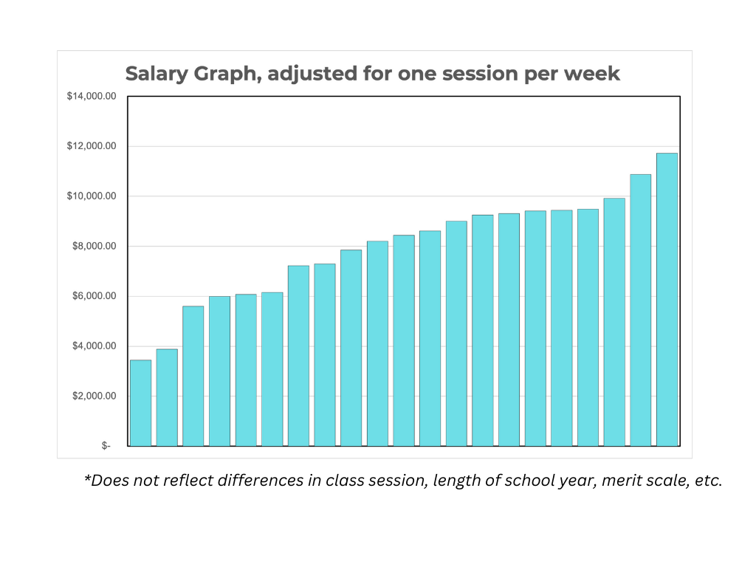
Salary
The average PCPO teacher salary was $7960/year based on one session/week, with a high of $11,720 and a low of $3,440.
This salary comparison adjusts reported salary to one session/week. It does not adjust for length of school day, merit scale level, contract year, or additional duties.
Notes:
Alison

Slide 40
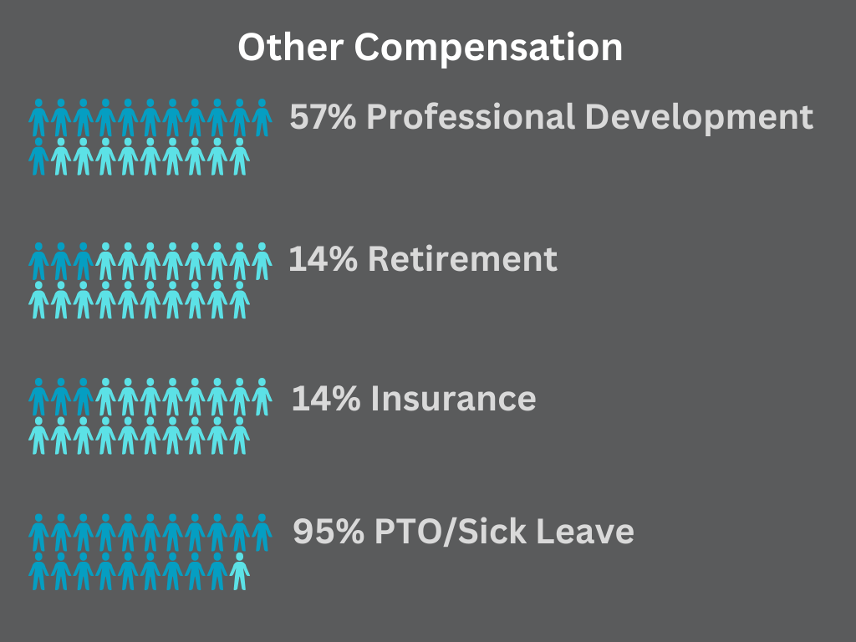
Notes:
Alison

Slide 41

Professional Development funds provided by contract range from $0 to $500.
Notes:
Alison

Slide 42
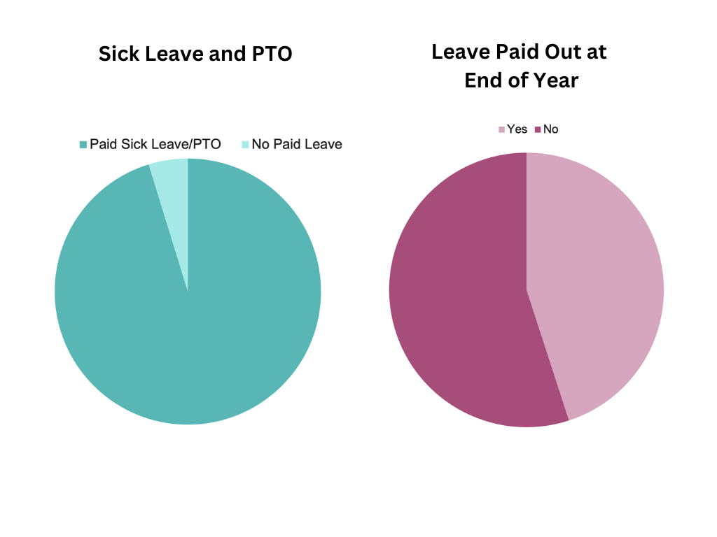
Sick Leave
All but one of responding teachers receive paid sick leave or PTO.
For those with paid leave policies, more than half do not receive a payout at the end of the year.
Notes:
Alison

Slide 43
What’s worse than finding a worm in your apple?
Finding half a worm!

Slide 44
2025 PCPO Minimum Salary Recommendations
Link to Packet: 2025 PCPO Teacher Contract, Salary, and Benefits Recommendations
Refer to the 2023-24 “PCPO Teacher Contract, Salary, and Benefits Recommendations” for more information
Notes:
Bethany. Bethany will drop the link in the chat

Slide 45
How to use PCPO’s Salary Recommendations
No two PCPO schools are alike!
Due to the wide variety of teacher contracted roles and responsibilities, PCPO issues a base rate of recommended salary.
Schools must adapt PCPO recommendations to fit their teacher’s contracted duties using the math equations contained in the salary packet or PCPO’s 2025 Minimum Salary Calculator tool.
  NOTE! The calculator tool must be used in conjunction with the information contained in the salary packet. Your teacher’s compensation package must be crafted to match the duties assigned in their individual contract.
Notes:
Bethany

Slide 46

The role of the co-op teacher is hard to compare. They often have more administrative duties than a conventional teacher, and more classroom duties than a director with paid support staff. This makes direct salary comparison a challenge!
Your school must take your teacher’s unique role into consideration when determining compensation packages.
Notes:
Bethany- Alison Can mention this is why glassdoor and other comparison sites are less useful for many schools. Participation in PCPO salary survey can help!

Slide 47
2025
Minimum Salary Recommendations
MERIT LEVEL | Annual Minimum Salary for One 2.5 hr Session / Week *
I | $3,851
II | $4,288
III | $5,095
IV | $5,857
V | $6,737
VI | $7,746
VII | $8,910
VIII | $10,247
 | Reflects 3.3% cost of living increase from last year.
Notes:
Alison - 3.3% cost of living. when you are looking at increases, our recommendation is to add 2% for step increase

Slide 48
Salary Calculations
Salary recommendations are based on the assumption that a PCPO teacher typically spends an equal amount of time engaged in school related activities outside of class as they do teaching each session.
These duties can include:
Curriculum Development
Planning
School Events
Parent communication/Office Hours
Board and parent meetings
Notes:
Alison - talk about piecemeal contracts. covers all work outside classroom hours – weekends, holidays, breaks, etc. Be specific as to what your school is including in these extra duties.

Slide 49
Step Increases
Recommended minimums listed reflect the increase in cost of living only
They do not address step increase
PCPO recommends an annual step increase of at least 2%
Example: PCPO would recommend the salary of a teacher who has been at Merit Level III for several years be above the Level III minimum. Annual “step increases” would gradually move the teacher’s salary toward the Merit Level IV compensation.
A small increase each year is much easier to budget for than a 15% increase in one year!
Notes:
Alison

Slide 50
PCPO
Recommendation
If your teacher is paid significantly less than the recommended minimum, we encourage your school to consider an increase that would raise the compensation to at least the minimum
Notes:
Alison

Slide 51

Teacher Appreciation
There are endless ways to appreciate and support your teacher beyond contracted compensation! Get creative!
  Meal Train during conferences, beginning/end of school
  Beach house!
  A pie a month!
  Morning Coffee Deliveries!
  Personal notes of gratitude
Your school’s membership will have different talents and resources to share each year! Have fun with it!
Notes:
Penny

Slide 52
Read your packet!
PCPO’s annual contract support packet contains more details than we could include in this presentation!
  Compliance with federal and state overtime laws
  Regional rules for sick time (both Washington and Oregon)
  OregonSaves program
  Merit Scale worksheet
Contact us with your questions!
Notes:
Alison

Slide 53

A good contract is going to be an incredible asset for your school for years to come. The time spent crafting a good contract is going to be so worth it!
Notes:
Molly

